Slide 1


Red Hat JBoss Fuse 6.0
Getting Started with JBoss Fuse 6.0
Sameer Parulkar, JBoss Product Marketing Manager
Kenneth Peeples, JBoss Technology Evangelist
April 16, 2012

Slide 2
JBoss Fuse Getting Started
Part 1 – JBoss Fuse Overview
Part 2 - Demonstration of a JBoss Fuse Enterprise Integration Pattern Quickstart

Slide 3

Part 1: JBoss Fuse
Overview

Slide 4
JBoss Fuse Overview
Product Launch for JBoss Fuse
Features and Benefits – JBoss Fuse

Slide 5
JBoss Fuse Launch Overview
JBoss Fuse - a small-footprint, flexible open source Enterprise Service Bus (ESB)
  Rebranding/Repackaging of Fuse ESB Enterprise
Includes JBoss A-MQ – a small-footprint, high performance messaging platform
  Rebranding/Repackaging of Fuse MQ Enterprise
GA for JBoss Fuse 6.0 and JBoss A-MQ 6.0 announced on Apr 11, 2013
Available in community for development use – Try our products!
  JBoss Fuse – http://jboss.org/products/fuse
  JBoss A-MQ – http://jboss.org/products/amq

Slide 6
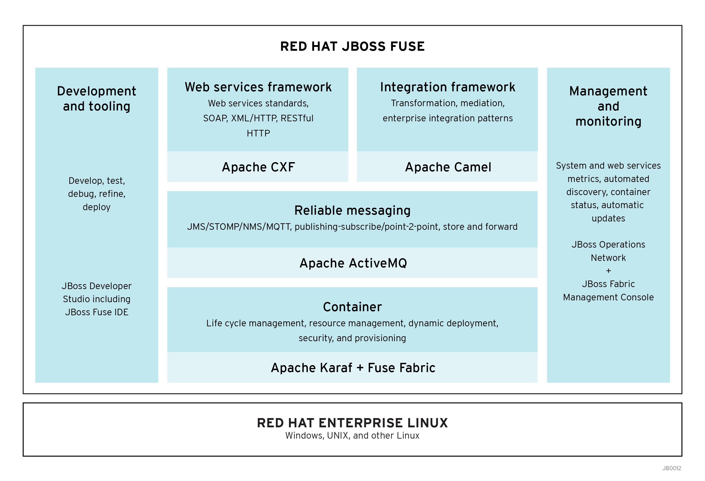
JBoss Fuse – Integration Everywhere!

Slide 7
JBoss Fuse Benefits
No license fees – Try before you buy, and deploy widely without incurring exorbitant costs
Faster time to solution – Includes Apache Camel®, the easiest way to rapidly integrate your enterprise assets
Extensive connectivity – includes connectivity for the most common tasks
Flexible configuration – Dynamic configurations enable customized solutions at every endpoint, distributor, outlet or device.
Proven reliability and Support – track record of supporting mission-critical applications and backed by Red Hat’s award winning support

Slide 8
Part 2: JBoss Fuse
Demonstration of a JBoss Fuse Enterprise Integration Pattern Quickstart

Slide 9
Topics Covered during the demonstration
How to define a Camel route using the Blueprint XML syntax
How to build and deploy a Fuse Application Bundle (FAB)
How to combine multiple Enterprise Integration Patterns (Wiretap, Splitter, Recipient List and Filter) to create an integration solution
How to define and use a bean to process a message
How to use a 'direct:' endpoint to link multiple smaller routes together

Slide 10
Scenario for Demonstration
First we want to make sure we retain a copy of the original orders file containing several orders for zoos around the world we received. This is done using the Wiretap EIP.
After saving the original, we want to split the file up into the individual orders. This is done using the Splitter EIP.
Then we want to store the orders in separate directories by geographical region. This is done using a Recipient List EIP.
Finally, we want to filter out the orders that container more than 100 animals and generate a message for the strategic account team. This is done using a Filter EIP.

Slide 11
Source Files used in the demonstration
Source files in the fuse-eip-quickstart project -
pom.xml - the Maven POM file for building the example
In src/main -
java/org.jboss.fuse.examples/eip/RegionSupport.java - a Java class used to determine the region code used by the recipient list
resources/OSGI-INF/blueprint/eip.xml - the OSGI Blueprint file that defines the routes
In src/test -
data/orders.xml - the data file that can be used to test the route
java/RegionSupportTest.java - a JUnit test class for RegionSupport

Slide 12
What are Enterprise Integration Patterns (EIP)?
Gregor Hohpe and Bobby Woolfe's book, Enterprise Integration Patterns: Designing, Building, and Deploying Messaging Solutions, contains a set of sixty five Enterprise Integration Patterns (EIPs).
Apache Camel is an open source Java framework that focuses on making integration easier and more accessible to developers. Camel provides:
• implementations of the widely used EIPs
• connectivity to multiple transports and APIs
• easy to use Domain Specific Language (DSL) to wire EIPs and transports together

Slide 13
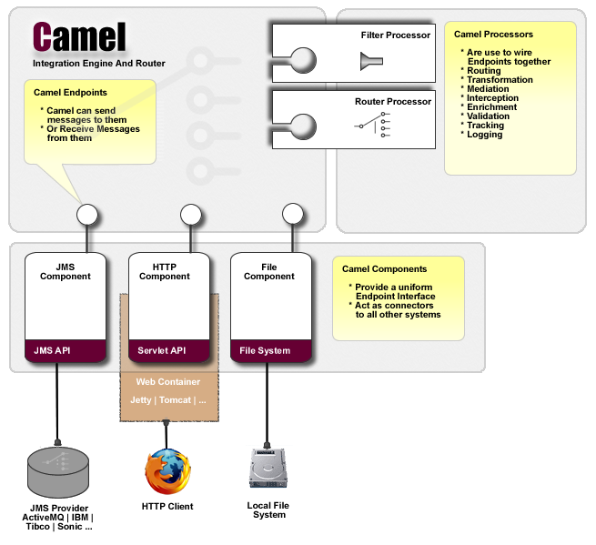
Camel Architecture
DSL used to wire endpoints and processors together to form routing rules

Slide 14
What is Camel DSL?
Camel uses a Java Domain Specific Language or DSL for creating Enterprise Integration Patterns or Routes in a variety of domain-specific languages (DSL) as listed below.
Java DSL - A Java based DSL using the fluent builder style.
Spring XML - A XML based DSL in Spring XML files
Blueprint XML - A XML based DSL in OSGi Blueprint XML files
Groovy DSL - A Groovy based DSL using Groovy programming language
Scala DSL - A Scala based DSL using Scala programming language
Annotation DSL - Use annotations in Java beans.
More Information: http://camel.apache.org/dsl.html

Slide 15
What are Camel URI Components?
http://camel.apache.org/file2.html - The File component provides access to file systems, allowing files to be processed by any other Camel Components or messages from other components to be saved to disk
http://camel.apache.org/direct.html - The direct: component provides direct, synchronous invocation of any consumers when a producer sends a message exchange. This endpoint can be used to connect existing routes in the same camel context.
More information: http://camel.apache.org/components.html

Slide 16
OSGI Blueprint File – eip.xml
<project_home>/projects/fuse-eip-quickstart/src/main/resources/OSGI-INF/blueprint/eip.xml - OSGI Blueprint file that defines the routes for our quickstart
This is the OSGi Blueprint XML file defining the Camel context and routes. Because the file is in the OSGI-INF/blueprint directory inside our JAR, it will be automatically activated as soon as the artifact is installed. The root element for any OSGi Blueprint file is 'blueprint' - you also see the namespace definitions for both the Blueprint and the Camel namespaces.
<blueprint xmlns="http://www.osgi.org/xmlns/blueprint/v1.0.0"
xmlns:xsi="http://www.w3.org/2001/XMLSchema-instance"
xsi:schemaLocation="
http://www.osgi.org/xmlns/blueprint/v1.0.0 http://www.osgi.org/xmlns/blueprint/v1.0.0/blueprint.xsd
http://camel.apache.org/schema/blueprint http://camel.apache.org/schema/blueprint/camel-blueprint.xsd">

Slide 17
OSGI Blueprint File - Continued
We are using the OSGi Blueprint XML syntax to define a bean that we use in our Camel route to determine the geographical region. The code for this bean can be found in src/main/java/org.jboss.fuse.examples/eip/RegionSupport.java
<bean id="MyRegionSupport" class="org.jboss.fuse.examples.eip.RegionSupport" />
The namespace for the camelContext element in Blueprint is 'http://camel.apache.org/schema/blueprint'. We can also define namespace prefixes we want to use in the XPath expressions in our CBR here. We defined the namespace prefix order so that we use the namespace from the order messages in the XPath expressions. While it is not required to assign id's to the <camelContext/> and <route/> elements, it is a good idea to set them for runtime management purposes (logging, JMX MBeans, ...)
<camelContext xmlns="http://camel.apache.org/schema/blueprint"
xmlns:order="http://fusesource.com/examples/order/v7"
id="eip-example-context">

Slide 18
OSGI Blueprint File - Continued
This is the main Camel route. In Camel, you can split up routes into more manageable bits and pieces and using a direct: endpoint to link those routes together again. In this case, files will be sent to the direct:splitter endpoint after a wiretap has sent a copy of the message to the direct:wiretap endpoint. The routes behind these endpoints are defined below.
<route id="mainRoute">
<from uri="file:work/eip/input" />
<log message="[main] Processing ${file:name}" />
<wireTap uri="direct:wiretap" />
<to uri="direct:splitter" />
<log message="[main] Done processing ${file:name}" />
</route>
This route starts with the direct:wiretap endpoint we used in our main route. Whenever the wiretap in the main route sends a message to this endpoint, the route below will log a human-friendly message and store a copy of the message in the work/eip/archive directory.
<route id="wiretapRoute">
<from uri="direct:wiretap" />
<log message="[wiretap] Archiving ${file:name}" />
<to uri="file:work/eip/archive" />
</route>

Slide 19
OSGI Blueprint File - Continued
This route starts with the direct:splitter endpoint we used in our main route. In this route, we will split a file containing multiple <order/> elements into separate messages, so we can store the orders in a separate directory for every geographical region.
<route id="splitterRoute">
<from uri="direct:splitter"/>
<split>
We are using XPath to split the message body. The namespace prefix, order, used in the XPath expression was defined on the camelContext element.
<xpath>//order:order</xpath>
Headers can be used to add meta-data to the message without altering the actual message body. In this case, we want to keep the order XML message, but we add two additional pieces of information:
- the order id : we use XPath to determine the order id
- the geographical region : we are using a method called getRegion() on the MyRegionSupport bean we defined earlier
<setHeader headerName="orderId">
<xpath>/order:order/@id</xpath>
</setHeader>
<setHeader headerName="region">
<method bean="MyRegionSupport" method="getRegion" />
</setHeader>

Slide 20
OSGI Blueprint File - Continued
Another human-friendly log message, this time using the extra headers we just added to the message
<log message="[splitter] Shipping order ${header.orderId} to region ${header.region}"/>
A recipient list can be used to dynamically determine the next steps for a message. In this case, we dynamically generate the file: endpoint uri using the two headers we defined earlier. We will also send the message to the direct:filter endpoint to see if the order needs attention from our strategic account management team.
<recipientList>
<simple>file:work/eip/output/${header.region}?fileName=${header.orderId}.xml,direct:filter</simple>
</recipientList>
</split>
</route>

Slide 21
OSGI Blueprint File - Continued
This route starts with the direct:filter endpoint we used in the <recipientList> in our splitter route. It uses a Filter EIP to filter out the order messages that contain more than 100 animals in a single order. For all messages that meet the XPath filter expression, an extra message will appear in the logs.
<route id="filterRoute">
<from uri="direct:filter" />
<filter>
<xpath>sum(//order:quantity/text()) > 100</xpath>
<log message="[filter] Order ${header.orderId} is an order for more than 100 animals" />
</filter>
</route>
</camelContext>

Slide 22
What is a Fuse Application Bundle (FAB)?
Fuse Bundles are designed to make it very easy for application developers to create applications that can be deployed in OSGi containers or web containers so that its:
easy to deploy and control which classes are shared across deployment units
there's a common model of class loaders across your build tool (e.g. Maven), your IDE (e.g. with Maven integration) and container with few surprises
developers can focus on getting things done rather than fighting OSGi metadata or struggling with OSGi specific metadata generation tools.
A Fuse Bundle, or FAB, is any jar created using Apache Maven or similar build tools so that inside the jar there is a pom.xml file at META-INF/maven/groupId/artifactId/pom.xml (and pom.properties file) which contain the transitive dependency information for the jar.
In your OSGi container such as Fuse ESB or Apache Karaf with the Fuse bundle feature installed - you can then install any FAB as if it were a WAR or Karaf feature.
To install a FAB with some value of groupId, artfactId, version type the following command into the console of either Fuse ESB or Apache Karaf (if it has the Fuse bundle feature installed)
install fab:mvn:groupId/artifactId/version
For More Information: http://fuse.fusesource.org/bundle/overview.html

Slide 23
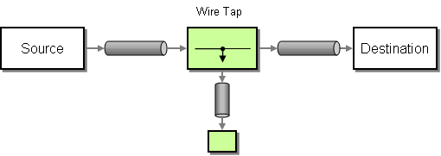
Wiretap - System Management EIP
Wire Tap, from the EIP patterns, allows you to route messages to a separate location while they are being forwarded to the ultimate destination
<route id="mainRoute">
<from uri="file:work/eip/input" />
<log message="[main] Processing ${file:name}" />
<wireTap uri="direct:wiretap" />
<to uri="direct:splitter" />
<log message="[main] Done processing ${file:name}" />
</route>
<route id="wiretapRoute">
<from uri="direct:wiretap" />
<log message="[wiretap] Archiving ${file:name}" />
<to uri="file:work/eip/archive" />
</route>

Slide 24
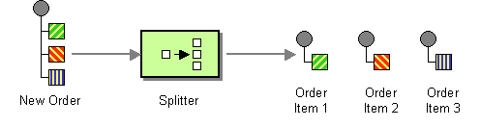
Splitter - Message Routing EIP
The Splitter, from the EIP patterns, allows you split a message into a number of pieces and process them individually
<route id="splitterRoute">
<from uri="direct:splitter"/>
<split>
<xpath>//order:order</xpath>
<setHeader headerName="orderId">
<xpath>/order:order/@id</xpath>
</setHeader>
<setHeader headerName="region">
<method bean="MyRegionSupport" method="getRegion" />
</setHeader>
<log message="[splitter] Shipping order ${header.orderId} to region ${header.region}"/>
<recipientList>
<simple>file:work/eip/output/${header.region}?fileName=${header.orderId}.xml,direct:filter</simple>
</recipientList>
</split>
</route>

Slide 25
Splitter - Message Routing EIP
The Splitter, from the EIP patterns, allows you split a message into a number of pieces and process them individually
<route id="splitterRoute">
<from uri="direct:splitter"/>
<split>
<xpath>//order:order</xpath>
<setHeader headerName="orderId">
<xpath>/order:order/@id</xpath>
</setHeader>
<setHeader headerName="region">
<method bean="MyRegionSupport" method="getRegion" />
</setHeader>
<log message="[splitter] Shipping order ${header.orderId} to region ${header.region}"/>
<recipientList>
<simple>file:work/eip/output/${header.region}?fileName=${header.orderId}.xml,direct:filter</simple>
</recipientList>
</split>
</route>

Slide 26
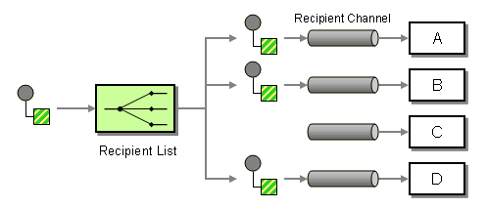
Recipient List - Message Routing EIP
The Recipient List, from the EIP patterns, allows you to route messages to a number of dynamically specified recipients.
The Recipient List, from the EIP patterns, allows you to route messages to a number of dynamically specified recipients.
<recipientList>
<simple>file:work/eip/output/${header.region}?fileName=${header.orderId}.xml,direct:filter</simple>
</recipientList>

Slide 27
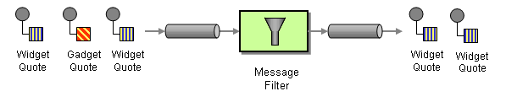
Message Filter - Message Routing EIP
The Message Filter, from the EIP patterns, allows you to filter messages.
<route id="filterRoute">
<from uri="direct:filter" />
<filter>
<xpath>sum(//order:quantity/text()) > 100</xpath>
<log message="[filter] Order ${header.orderId} is an order for more than 100 animals" />
</filter>
</route>

Slide 28
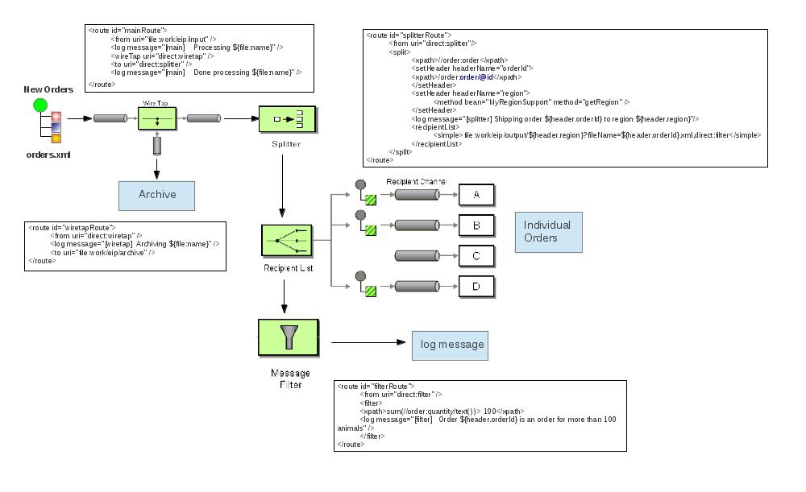

Slide 29
Prerequisites
Source
Maven 3.0.3 or higher
JDK 1.7
JBoss Fuse 6
JBoss Developer Studio 6
https://github.com/kpeeples/fuse-eip-quickstart.git

Slide 30
Demonstration Steps
Step 1 – View the README in 'installs' directory
Step 2 – Add the JBoss Fuse product from the Red Hat Customer Support Portal or JBoss.org
Login to RHN or jboss.org
https://www.jboss.org/products/fuse.html
https://access.redhat.com/jbossnetwork/restricted/listSoftware.html?downloadType=distributions&product=jboss.fuse&productChanged=yes
update the zip filename in init.sh in the FUSE_BIN variable
Step 3 - Run 'init.sh' & read output
sample posted to init.sh.output under support
Step 4 - Install and/or Setup JBDS for project import
Indicate where to get the JBDS
Step 5 - Add the JBoss Fuse server
admin=redhat,admin update users.properties in /etc first
Step 6 - Import the maven project to review the files
Step 7 - Start JBoss Fuse
[kpeeples@localhost bin]$ ./fuse Please wait while JBoss Fuse is loading... 100% [=================================================================]
JBoss Fuse (6.0.0.redhat-015) http://www.redhat.com/products/jbossenterprisemiddleware/fuse/
Hit '' for a list of available commands and '[cmd] --help' for help on a specific command. Hit '' or 'osgi:shutdown' to shutdown JBoss Fuse.
JBossFuse:karaf@root>
Step 8 - When the JBoss Fuse console appears, install the Fuse Application Bundle (FAB)
JBossFuse:karaf@root>osgi:install -s fab:mvn:org.jboss.fuse.examples/eip/6.0.0.redhat-024
show .m2 repo
view the OSGi list to make sure the FAB has been created and active
osgi:list - l
[ 234] [Active ] [Created ] [ ] [ 60] fab:mvn:org.jboss.fuse.examples/eip/6.0.0.redh
at-024

Slide 31
Demonstration Steps
Step 9 - As soon as the Camel route has been started, you will see a directory `work/eip/input` in your JBoss Fuse installation.
Step 10 - Copy the file you find in this example's `src/test/data` directory to the newly created `work/eip/input` directory.
Step 11 - Wait a few moment and you will find multiple files organized by geographical region under
`work/eip/output':
** `2012_0003.xml` and `2012_0005.xml` in `work/eip/output/AMER`
** `2012_0020.xml` in `work/eip/output/APAC`
** `2012_0001.xml`, `2012_0002.xml` and `2012_0004.xml` in `work/eip/output/EMEA`
Step 12 - Use `log:display` on the ESB shell to check out the business logging.
[main] Processing orders.xml
[wiretap] Archiving orders.xml
[splitter] Shipping order 2012_0001 to region EMEA
[splitter] Shipping order 2012_0002 to region EMEA
[filter] Order 2012_0002 is an order for more than 100 animals

Slide 32
Log Display
18:35:50,229 | INFO | //work/eip/input | mainRoute | 130 - org.apache.camel.camel-core - 2.10.0.redhat-60024 | [main] Processing orders.xml
18:35:50,235 | INFO | ead #2 - WireTap | wiretapRoute | 130 - org.apache.camel.camel-core - 2.10.0.redhat-60024 | [wiretap] Archiving orders.xml
18:35:50,268 | INFO | //work/eip/input | splitterRoute | 130 - org.apache.camel.camel-core - 2.10.0.redhat-60024 | [splitter] Shipping order 2012_0001 to region EMEA
18:35:50,325 | INFO | //work/eip/input | splitterRoute | 130 - org.apache.camel.camel-core - 2.10.0.redhat-60024 | [splitter] Shipping order 2012_0002 to region EMEA
18:35:50,369 | INFO | //work/eip/input | filterRoute | 130 - org.apache.camel.camel-core - 2.10.0.redhat-60024 | [filter] Order 2012_0002 is an order for more than 100 animals
18:35:50,373 | INFO | //work/eip/input | splitterRoute | 130 - org.apache.camel.camel-core - 2.10.0.redhat-60024 | [splitter] Shipping order 2012_0003 to region AMER
18:35:50,412 | INFO | //work/eip/input | filterRoute | 130 - org.apache.camel.camel-core - 2.10.0.redhat-60024 | [filter] Order 2012_0003 is an order for more than 100 animals
18:35:50,415 | INFO | //work/eip/input | splitterRoute | 130 - org.apache.camel.camel-core - 2.10.0.redhat-60024 | [splitter] Shipping order 2012_0004 to region EMEA
18:35:50,456 | INFO | //work/eip/input | splitterRoute | 130 - org.apache.camel.camel-core - 2.10.0.redhat-60024 | [splitter] Shipping order 2012_0005 to region AMER
18:35:50,497 | INFO | //work/eip/input | splitterRoute | 130 - org.apache.camel.camel-core - 2.10.0.redhat-60024 | [splitter] Shipping order 2012_0020 to region APAC
18:35:50,539 | INFO | //work/eip/input | mainRoute | 130 - org.apache.camel.camel-core - 2.10.0.redhat-60024 | [main] Done processing orders.xml

Slide 33
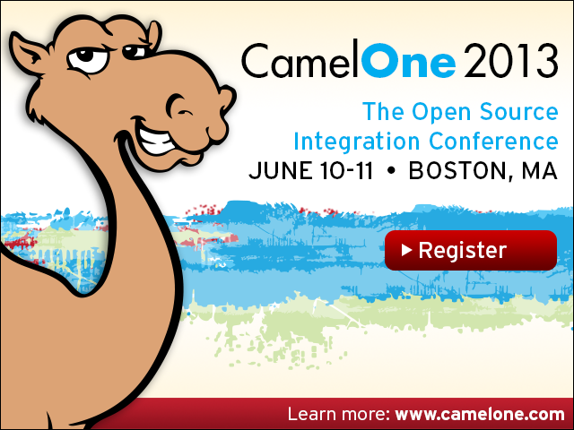

Slide 34
References
http://camel.apache.org/components.html
http://camel.apache.org/enterprise-integration-patterns.html
http://camel.apache.org/recipient-list.html for the Recipient List EIP
http://camel.apache.org/wire-tap.html for the Wire Tap EIP
http://camel.apache.org/message-filter.html for the Message Filter EIP
http://camel.apache.org/splitter.html for the Splitter EIP

Slide 35
Contact Information
Sameer Parulkar
Product Marketing Manager
sparulka@redhat.com
Kenneth Peeples
JBoss Technology Evangelist
kpeeples@redhat.com

Slide 36
Cleanup to initialize demo
Remove target in fuse-eip-quickstart
Remove target in project subdirectory in fuse-eip-quickstart
Remove Server instance
Remove workspace

